Slide 1
Java3D
Presented By
Chris Gundlach
chris@paragenix.com

Slide 2
Why Java3D?
People like rich applications (see Google Local).
AJAX stinks -- Javascript.
Flash stinks -- Javascript.
Java2D/Java3D can produce highly creative and high performance UI’s.
Java Security is the enabler.

Slide 3
History/Future
First version 1998
Development stopped 2003-2004. Now Open Source.
Previous version is 1.3.2, which is a bug fix release (Windows, Linux, Solaris, OS X).
Current version 1.4 3/2/06 (Windows, Linux, Solaris) adds programmable shaders.
Version 1.5 JOGL Rendering

Slide 4
3D Java APIs
JOGL – A Java based OpenGL rendering API
LWJGL (Lightweight Java Game Library) – Low level API targeted for games
Java3D – A Scenegraph API
Xith3D – Scenegraph API based on JOGL or LWJGL
jME (jMonkey Engine) – Scenegraph API based on LWJGL
Notes:
Light Weight Java Game Library – Games. Xith

Slide 5
OpenGL Sample
void renderTeapot (GLfloat x, GLfloat y, GLfloat z, GLfloat ambr, GLfloat ambg, GLfloat ambb, GLfloat difr, GLfloat difg, GLfloat difb, GLfloat specr, GLfloat specg, GLfloat specb, GLfloat shine) {
GLfloat mat[4];
glPushMatrix();
glTranslatef (x, y, z);
mat[0] = ambr; mat[1] = ambg; mat[2] = ambb; mat[3] = 1.0;
glMaterialfv (GL_FRONT, GL_AMBIENT, mat);
mat[0] = difr; mat[1] = difg; mat[2] = difb;
glMaterialfv (GL_FRONT, GL_DIFFUSE, mat);
mat[0] = specr; mat[1] = specg; mat[2] = specb;
glMaterialfv (GL_FRONT, GL_SPECULAR, mat);
glMaterialf (GL_FRONT, GL_SHININESS, shine*128.0);
glCallList(teapotList);
glPopMatrix(); }
Notes:
Notice that the code is very procedural and state oriented. SGI calls it like assembly for graphics. Not OO. Ex. in C.

Slide 6
Rendering
Java3D renders is done with either OpenGL or Direct3D (Windows).
Java3D will be moving to using JOGL bindings
Hardware Acceleration == Goodness
Works on a wide variety of hardware (a T40 ThinkPad for instance).
Notes:
The rendering code is currently C/JNI that calls the appropriate libs (i.e. Direct3D or OpenGL). ATI and NVidia.

Slide 7
JOGL Rendering
Remove the current rendering code from Java 3D, will allow the project to focus on the scenegraph.
JOGL implementations are available for more platforms (eg. OS X).
Will allow for a lightweight component.
6 to 9 months to complete
Notes:
The rendering code is currently C/JNI that calls the appropriate libs (i.e. Direct3D or OpenGL). ATI and NVidia.

Slide 8
Performance
3 Rendering Modes
Immediate Mode
Retained Mode
Compiled-Retained Mode
Uses the set capabilities flags to notify the API, what optimizations it can make.
Notes:
All the examples are C-R mode.

Slide 9
Capabilities
ALLOW_READ_BOUNDS
ALLOW_APPEARANCE_WRITE
ALLOW_GEOMETRY_WRITE
Notes:
All the examples are C-R mode.

Slide 10
UI Clases
Canvas3D -- is the heavyweight component where the scene is rendered.
GraphicsConfigTemplate3D – contains instructions for rendering (for instance anti-aliasing).
J3DGraphics2D for drawing on the Canvas3D using 2D instructions (not in compiled mode).
Notes:
Virtual Universe encompases everything. Multiple locales per universe.

Slide 11
Component Descriptions
VirtualUniverse - top level container of the scenegraph (SimpleUniverse)
Locale – Hi resolution location in the Universe
Group – Contains other Nodes
Leaf – Shapes, Behavior, Light, Background
Notes:
Virtual Universe encompases everything. Multiple locales per universe.

Slide 12
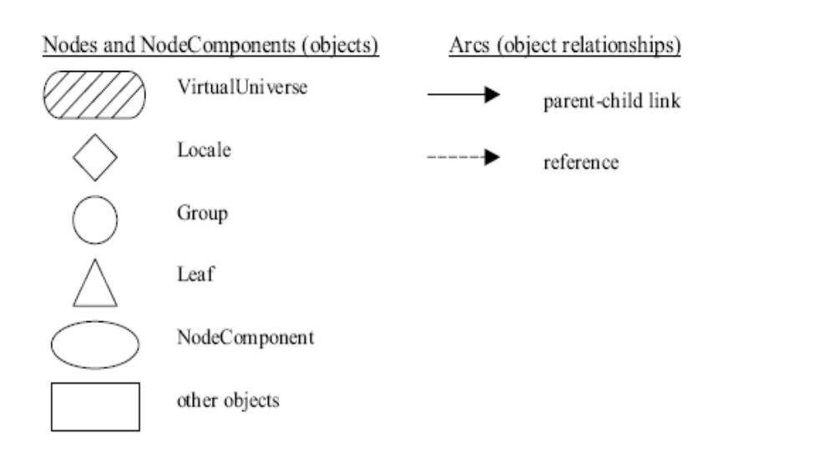
Scenegraph Components
Notes:
These are the standard notations used in the Java3D spec.

Slide 13
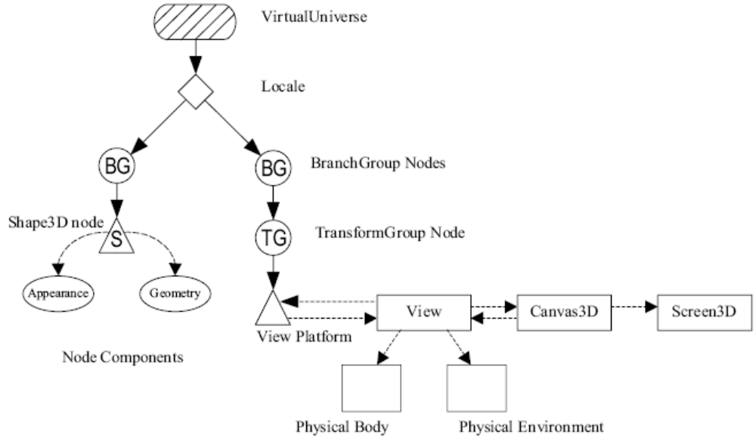
Sample Graph

Slide 14
Coordinates
Default unit of measure is meters
+x is to the right
+y is local gravitation up
+z is towards the viewer
Hires Coordinates are 256 bit fixed point numbers for x,y,z

Slide 15
BranchGroup
Extends Group functionality
compile() method
optimizes the contents of the group
detach() method
removes the group from the graph

Slide 16
Shape3D
Geometry
Examples -- LineArray, PointArray, QuadArray, TriangeArray, Text3D
Appearance
  ColoringAttributes, Texture, Material,
  TranparencyAttributes

Slide 17
Lighting
AmbientLight – Light that affects all objects uniformly.
DirectionalLight – Oriented light with origin at infinity.
PointLight – Located at some coordinate and emanates in all directions.
SpotLight – Located at some coordinate, and shines in a particular direction.

Slide 18
TranformationGroup
Provides a mechanism to scale, rotate, move, etc. a subgraph.
Transform3D
  rotX, rotY, rotZ
  set(scale)
  setTranslation(Vector3d)

Slide 19
Behaviors/Interpolator
Adds action to the scenegraph.
SchedulingBounds, SchedulingInterval
Interpolator is essentially a given transformation over time.
Examples: PositionInterpolator, ScaleInterpolator, RotationInterpolator

Slide 20
Loading Models
Instantiate your loader…
(extends com.sun.j3d.loaders.LoaderBase)
call load
get the Scene object
get the BranchGroup from the Scene
add the Group to your graph

Slide 21
Loaders
Lightwave and Wavefront included (com.sun.j3d.loaders…)
3D Studio Max
AC3D
VRML
Different loaders have different levels of ability to load in things like behaviors.
http://java3d.j3d.org/utilities/loaders.html

Slide 22
References
Java3D specification
Killer Game Programming in Java
Java3D home on java.net.
https://java3d.dev.java.net/

